Slide 1
Preservation Validation
Rob Gardner

Slide 2
ATLAS Run 1 (2009-12)
130 petabytes
600k datasets in various formats
355 million files
Various processing task categories
800 active users, several analysis frameworks
Focus for early DASPOS research?
“Big” data preservation? ☹
Analysis level data preservation? ☺
Implicit that preservation includes usability

Slide 3
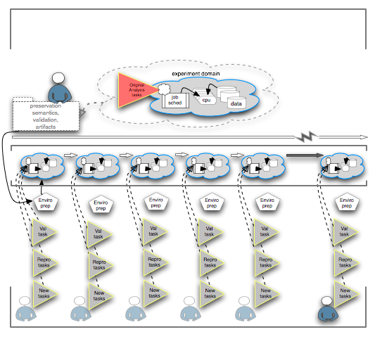
Time

Slide 4
Ingredients
Use case description
Selection (curate)
Inputs: data, platform, official repositories, dependent database objects, analysis framework, user application
Execution recipe defined certification objects

Slide 5
