Slide 1
Data And HEP
An overview
G. Watts
DASPOS 2012-12-18

Slide 2
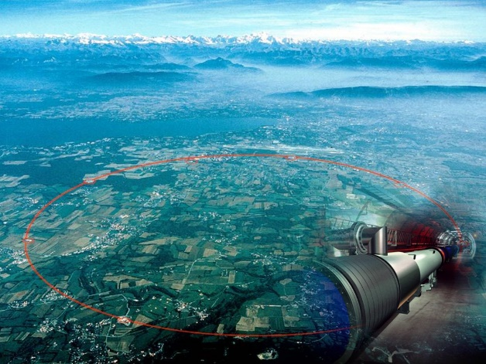
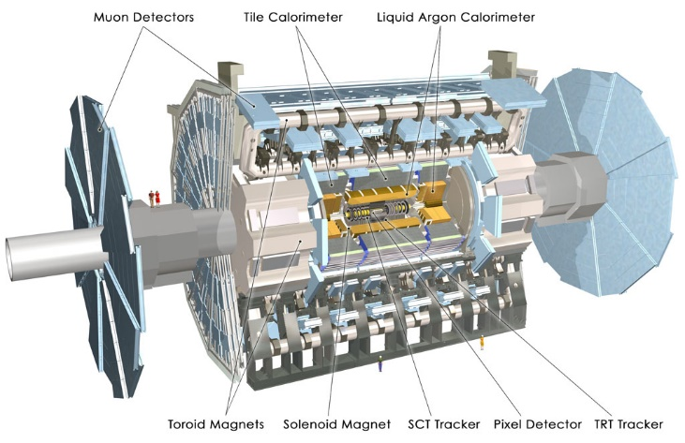
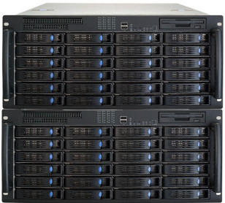
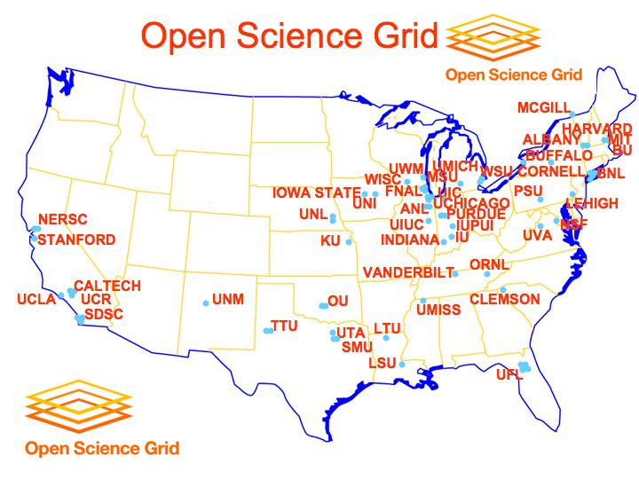
The View From outter Space
THE LHC
Data Storage
The Detector
The GRID
Paper

Slide 3
We care only about the last 3 steps
The GRID
Data Storage
Paper
Calibrations
Reconstruction Algoirthms
Analysis Code & Techniques
Monte Carlo Samples
Duct Tape (Scripts)
How we do it now is not necessarily the right way to do it 20 years from now

Slide 4

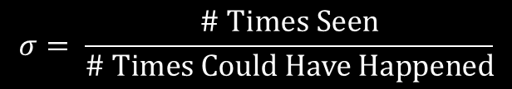



Measurements We make
How often does something happen?
$$σ= \frac{\text{\# }\text{Times} \text{Seen}}{\text{\# }\text{Times} \text{Could} \text{Have} \text{Happened}}$$
“Cross Section”
$$σ=\frac{N}{ℒ}$$
Count number of times it happened in our detector
Integrated Luminosity – How many collisions of all types occurred in the detector?
$$N=N_{\text{Count}}−N_{B}$$
Some expected physics process that will look just like what we are searching for
Count of some configuration of $e, μ,$etc.

Slide 5

$$ℒ$$
THE LHC
The luminosity sub-system records how often:
Two proton bunches pass through each other in the detector
The detector is turned on and looking for data
The Detector
Recorded in a large database
Also contains quality information
(Hadronic calorimeter had N dead channels)

Slide 6
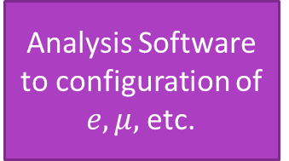


$$N_{\text{Count}}$$
Calibrations
Efficiency/Fake Rates
Reconstruction
Analysis Software to configuration of $e, μ,$etc.
Data Storage
$$N_{\text{Count}}$$

Slide 7


$$N_{B}$$
Background Generator
Calibrations
Efficiency/Fake Rates
Detector Simulator
Reconstruction
Analysis Software to configuration of $e, μ,$etc.
$$N_{\text{B}}$$

Slide 8
What happens to the data?
Raw Data
Data Storage
The electronic readout signals from the detector
The amount of charge in the pixel detector at (x, y, z)
Not directly useful!
Calibrations
(fake/eff curves, charge, etc.)
Reconstructed Objects
Most valuable
Often have multiple copies stored
Everything comes from the Raw data!

Slide 9

Not all RAW data is the same…
Physics Data Stream
Very careful accounting of the Luminosity
Sub-streams by event configuration (e, $μ$, etc.)
The Detector
Calibration Data Stream
Used to determine face rate curves, etc.
Luminosity is not always carefully tracked

Slide 10
Raw Data Evolves in time
Components fail, they are repaired
All changes are tracked in databases
The Detector
Substantial upgrades occur
(e.g. new detector added in 2013 shutdown)
This is often tracked implicitly – file formats change!
The Detector++

Slide 11
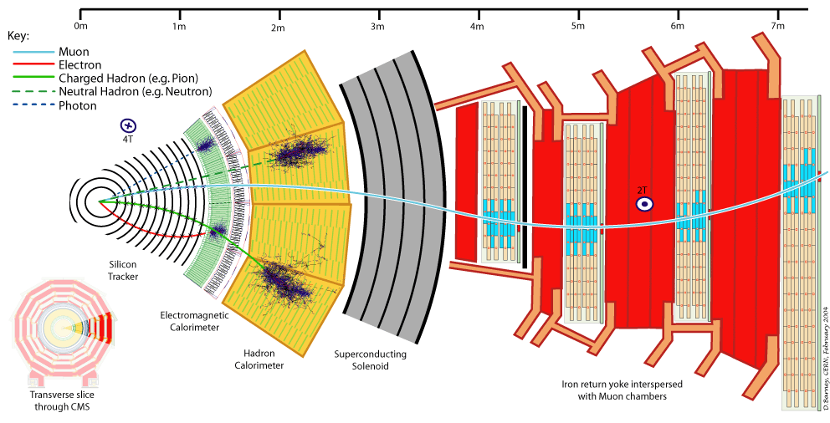
The reconstruction
Convert detector hits into physics objects:
Electrons, muons, tau’s
Jets
Missing Energy
Calibrations
Reconstruction
Combines data from different sub-detectors
Calibrations
Algorithms

Slide 12
Reconstruction also varies over time!
Input calibrations
Specific algorithm used to find an electron
Software Release
A database tracks every single source file that goes into the giant reconstruction program.
Software repository is used to track source code (SVN).
Calibration Database
Contains all the detector calibrations
Tagged and some how married with the software release often

Slide 13
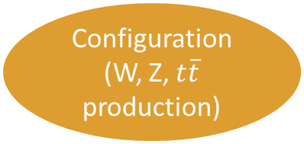
Generation and simulation
Background Generator
Configuration
(W, Z, $t\overline{t}$ production)
Detector Simulator
Software Release
Tracks the generators
Tracks the code that simulates the detectors
Tracks the group of configuration files (often)

Slide 14
The Files
Both the reconstruction and the simulation generate a large number of files
The provenance of every file must be tracked
Software release
Configuration files that were input
Scripts used to build it
What input files were used
“large” databases keep track of this information

Slide 15
GRID Processing
The file provenance database is often integrated with the GRID and/or production system
This automates the file tracking
BUT… the physicist doing the actual analysis… the last step…
Download files to their local computer/cluster
Run repeatedly locally, in a variety of different tools
Connection to the database is lost, provenance must be tracked by hand

